Slide 1
STRUCTURAL REPRESENTATION OF MODEL (Examining Growth Rate and fall rate in foreign exchange rates)
DATA SCIENCE CAPSTONE PROJECT
By UDBHAV SINGH PATWAL

Slide 2

ARCHITECTURE
This is a basic time series model implemented in Python language.
The IDE is used of Anaconda(Jupyter notebook).
Data has been stored in pandas.Dataframe variable.
Model Visualization has been done through Matplotlib library.

Slide 3

Advanced Features
MODEL
It is built through tensorflow.keras.
The neural networks used are LSTM.
Arrays have been built using numpy library.
Notebook
Jupyter Notebook
Python v3.7
Tensorflow v2.x

Slide 4
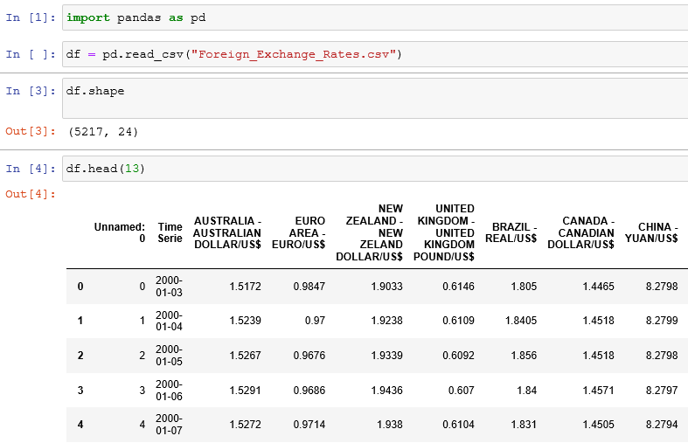
DATA ASSESMENT
Through ETL process we were able to identify our dataset(No. of features, Shape)
It had 5712 rows and 24 columns.
Data had little bit of ambiguity which was further cured.

Slide 5
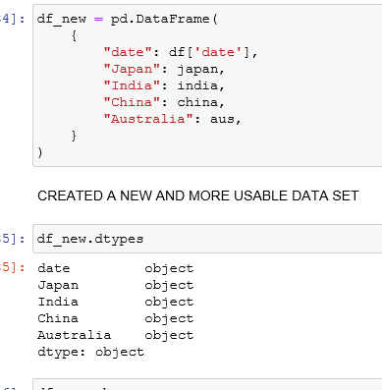
FEATURE TRANSFORMATION
Further ahead we had to transform are data to make it usable.
For that purpose we had to rename and change type of various columns.
Define New Columns for training.
And created well defined data set for training.

Slide 6
MODEL
Model as told above was built on LSTM(long short term memory).
There were 4 layers described in it.
For scoring purpose the loss function was mean average error .
And activation function was ‘Adam’

Slide 7
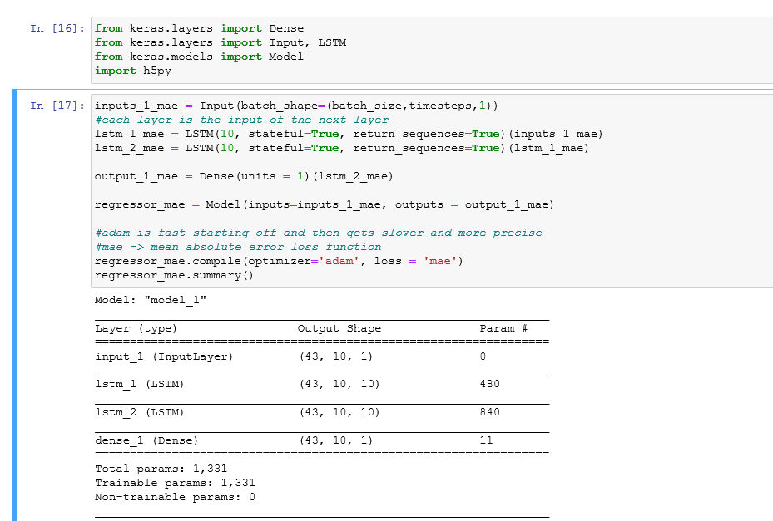

Slide 8
MODEL ALGORITHM
MODEL’ algorithm was basic LSTM aproach.
One input layer
Two LSTM layers
One dense layer
This Recurrent Neural Network was built for time series data and had an epoch of 43.

Slide 9
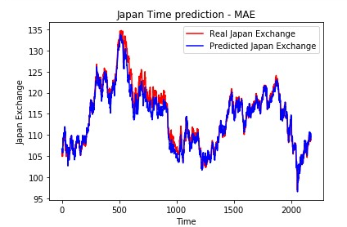
Predictions
Model evaluation was done on a test + train data set.
And had a really nice rate.

Slide 10
THANK YOU

